Slide 1







Slide 2
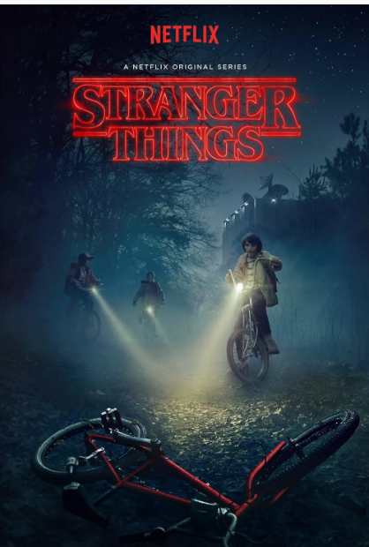

INTRO
1. Streaming Service: Netflix offers diverse streaming content worldwide on multiple devices.
2. Original Content: Netflix creates popular original series and films.
3. Global Reach: Available in over 190 countries, Netflix has a massive global presence.
4. User Experience: Uses algorithms to recommend personalized content to users.
5. Award-Winning: Netflix has garnered numerous prestigious awards for its content.
Interesting Fact Netflix began as a DVD rental service before pivoting to streaming, reshaping media consumption.

Slide 3

motivation
This dashboard is created to distill and visualize essential data regarding Netflix's highest-rated programs and popular genres, facilitating strategic decision-making in content curation.
The aim is to leverage this tool to accurately identify trends and viewer preferences, ensuring the content strategy is proactive and aligned with viewer demands for improved engagement and satisfaction.

Slide 4

ABOUT THE DATASET
1. Dataset Overview: The dashboard uses a comprehensive dataset from Kaggle featuring extensive listings of Netflix content, including details like cast, directors, ratings, release year, and duration.
https://www.kaggle.com/datasets/shivamb/netflix-shows
2. Data Interpreter Use: Implemented a data interpreter to clean and structure the dataset, ensuring the data’s integrity and usability for analysis.
3. Selective Retention of Columns: Focused on retaining key columns critical for assessing viewer preferences and content performance, streamlining the dataset for more effective analysis.
4. Genre Categorization: Restructured the genre data by grouping similar genres into broader categories, facilitating more nuanced insights into viewer trends.
5.Strategic Data Editing: These edits were strategically designed to enhance our ability to draw actionable insights, helping to inform decisions on content strategy and optimize viewer engagement.
MORE INFORMATION

Slide 5
Worksheet

Slide 6


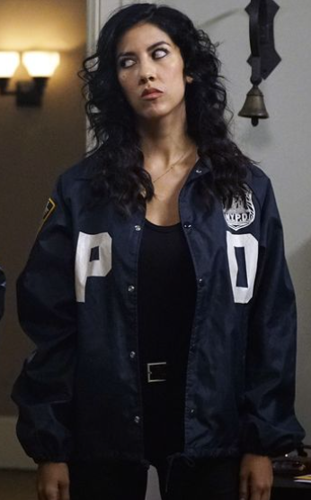
Worksheets
Total movies and TV shows by country
Total movies and shows
No of movie shows addded by years
Top 10 genre
Ratings
Top directors
Top 10 cast /actors
LEARN MORE

Slide 7
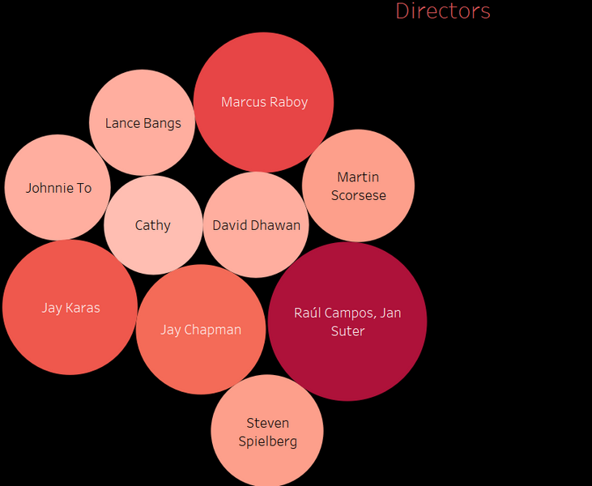
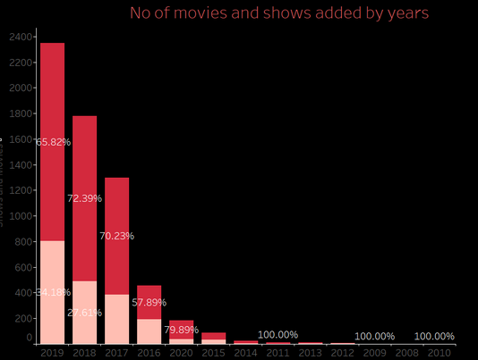
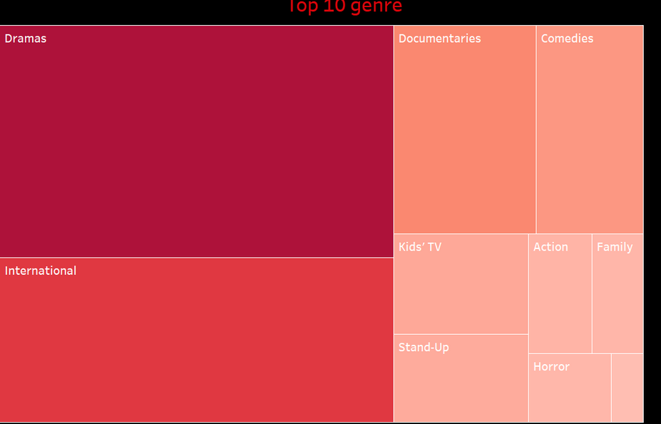
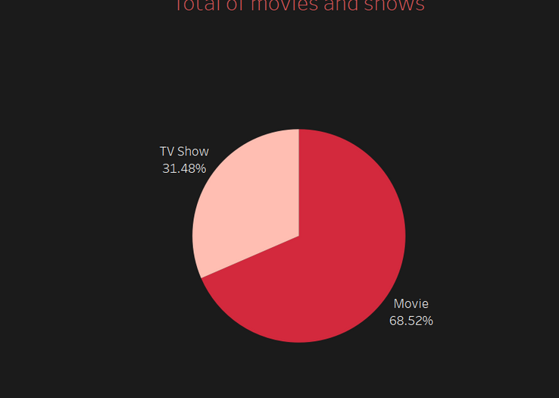

Slide 8

There's a one-line elaboration for each of the visualizations provided:
Movies and TV Shows Pie Chart Compares the proportion of movies to TV shows available on Netflix, with movies making up a larger percentage.
Top 10 Genres Treemap: Illustrates the popularity of various genres on Netflix, with 'Dramas' and 'International' being the most prevalent.
Content Addition Over Years Bar Chart Tracks the number of movies and shows added to Netflix annually, highlighting a trend of fluctuating additions over recent years.
Directors Bubble Chart: Represents the frequency of titles by directors, with larger bubbles indicating directors who have more titles on Netflix.

Slide 9
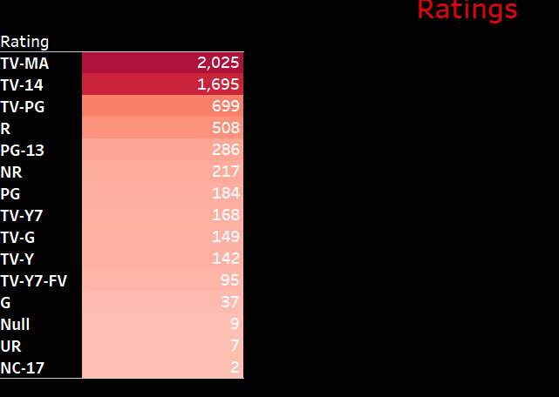
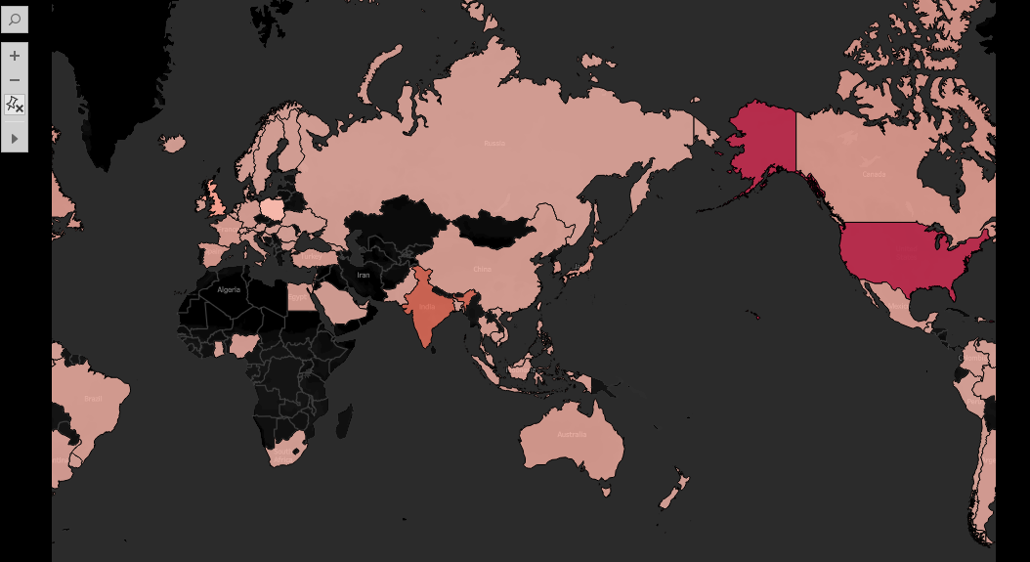
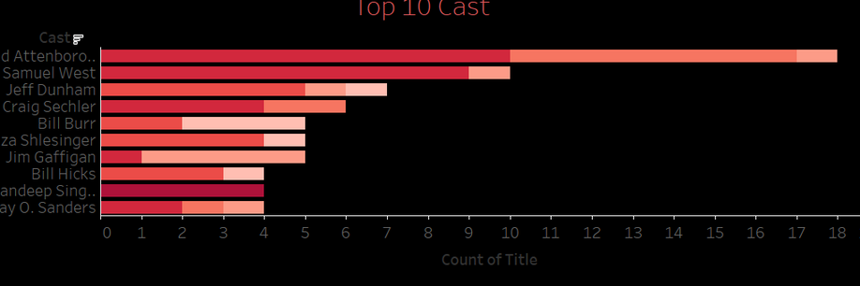

Slide 10

Top 10 Cast Bar Chart Details the most featured actors in Netflix titles, showcasing those who appear most frequently across various shows and movies.
World Map Visualization:Displays the global distribution of Netflix content availability, highlighting regions with varying access levels.
Content Ratings Bar Chart: Shows the distribution of content ratings on Netflix, with 'TV-MA' and 'TV-14' being the most common.

Slide 11
DASHBOARD DEMO

Slide 12
Story DEMO

Slide 13

FuTURE SCOPE
Subscriber Trends: Visualize subscriber growth or decline over time, segmented by region and subscription type.
Recommendation Effectiveness: Track click-through and completion rates of recommended content to assess its impact.
User Engagement: Monitor metrics like average watch time, usage frequency, and bounce rates.
Sentiment Analysis: Analyze social media to understand public sentiment towards Netflix content.

Slide 14



REFERENCES
Informations
Data set
https://www.kaggle.com/datasets/shivamb/netflix-shows
About
https://www.netflix.com/
https://en.wikipedia.org/wiki/Netflix
https://en.wikipedia.org/wiki/List_of_Netflix_original_films_(since_2024)
Sound
https://forum.videohelp.com/threads/412565-Downloading-videos-from-Tudum-(Netflix-fansite)

Slide 15

tHANK YOU

